Slide 1
Event Filtering

Slide 2
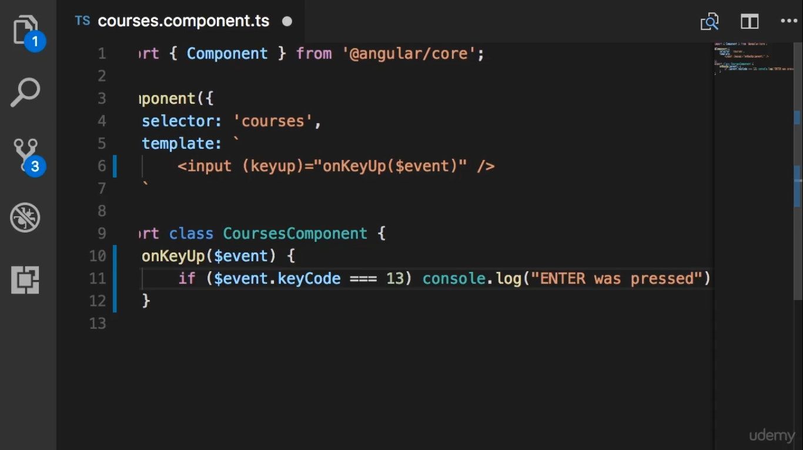

Slide 3
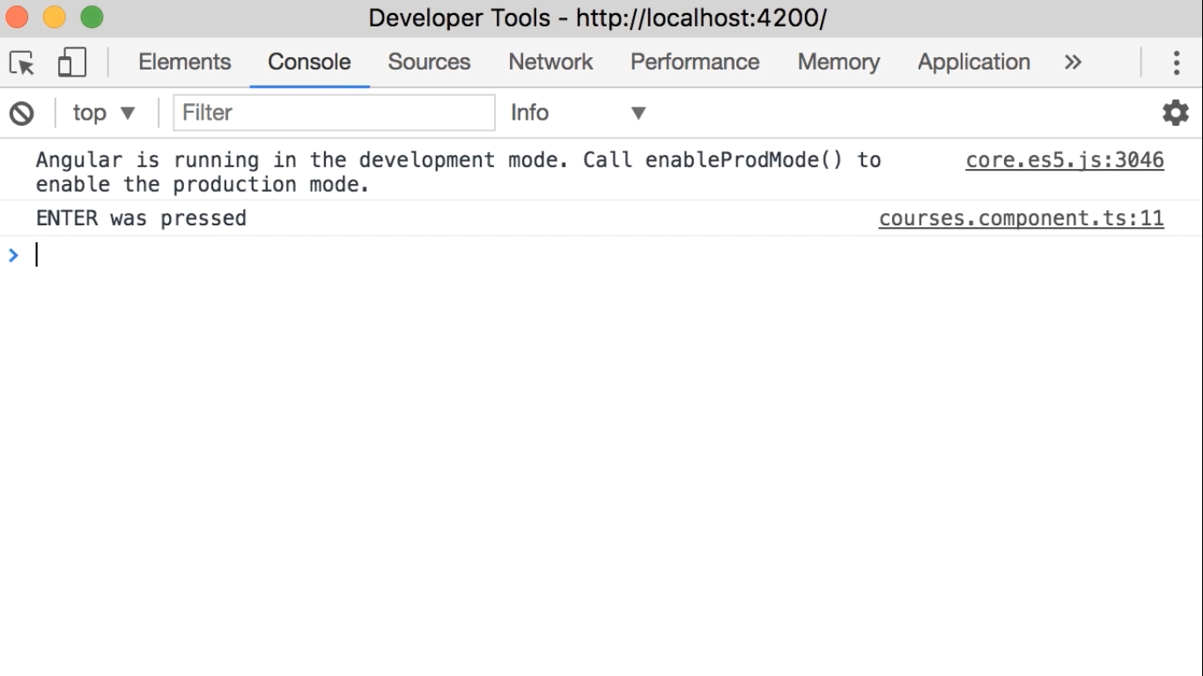

Slide 4
